Slide 1
Jenkins Steps
Sarita Lad
DATE

Slide 2
Jenkins:
Step 1 download Jenkins (JDK 11 or 17 install and set path
Step 2 place war file into any location of your system
Step 3 goto that folder
C:\users\HP\> java –jar Jenkins.war
Step 4 : goto browser http://localhost:/8080
Step 5: install required plugins
Step 6: get started with Jenkins

Slide 3
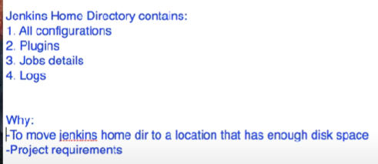
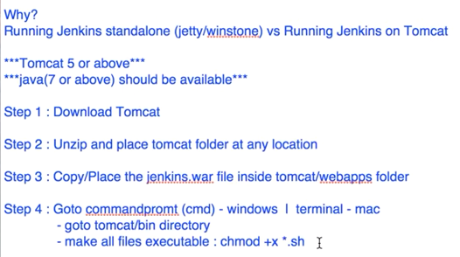
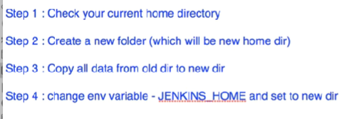
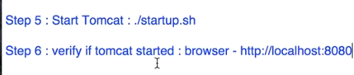
https://www.youtube.com/watch?v=Fi9pgrMlQZY&t=83s

Slide 4
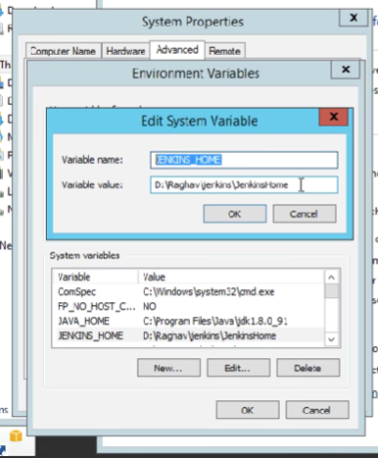
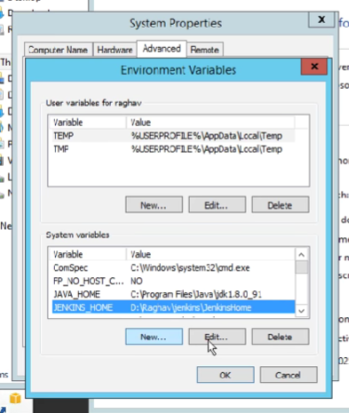

Slide 5
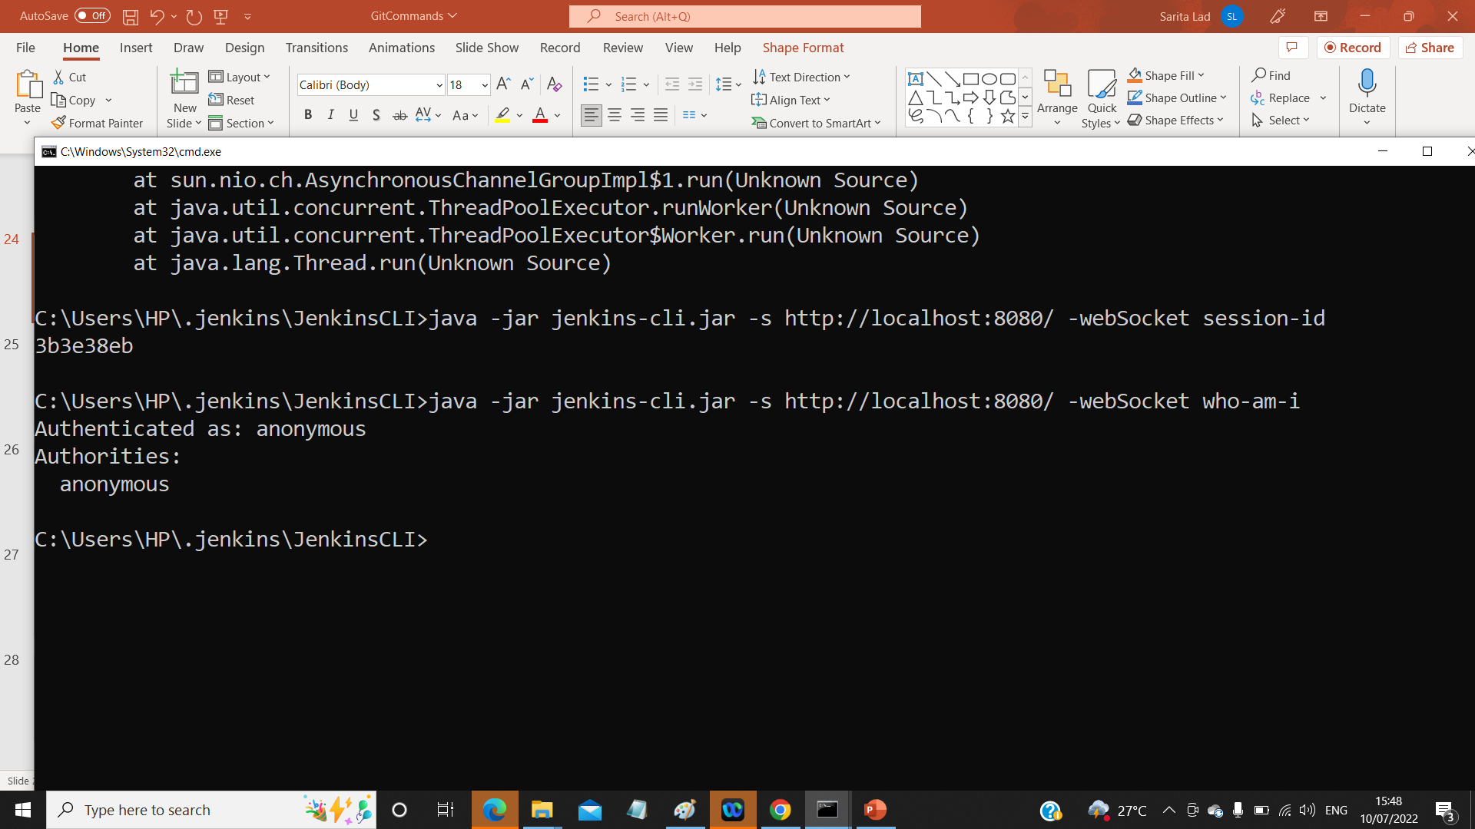
C:\users\HP> java-jar Jenkins.war –httpport =9090 to run on different port
User admin
Password admin
==================================
Why to use CLI tools?
Easier
Faster
Memory management efficient
Continuous Integration
==========================================
Step 1 :Start Jenkins:
Step 2:Goto manage Jenkins=>Configure global security ➔ enable security
Step 3:goto http://loclhost:8080/CLI YOU WILL GET LIST OF CLI COMMANDS
Step 4:download Jenkins-cli.jar place at any location see setting of global security setting on next slide.
Step 5:java -jar jenkins-cli.jar -s http://localhost:8080/ -webSocket help
Step 6: ex:
java -jar jenkins-cli.jar -s http://localhost:8080/ -webSocket who-am-i

Slide 7
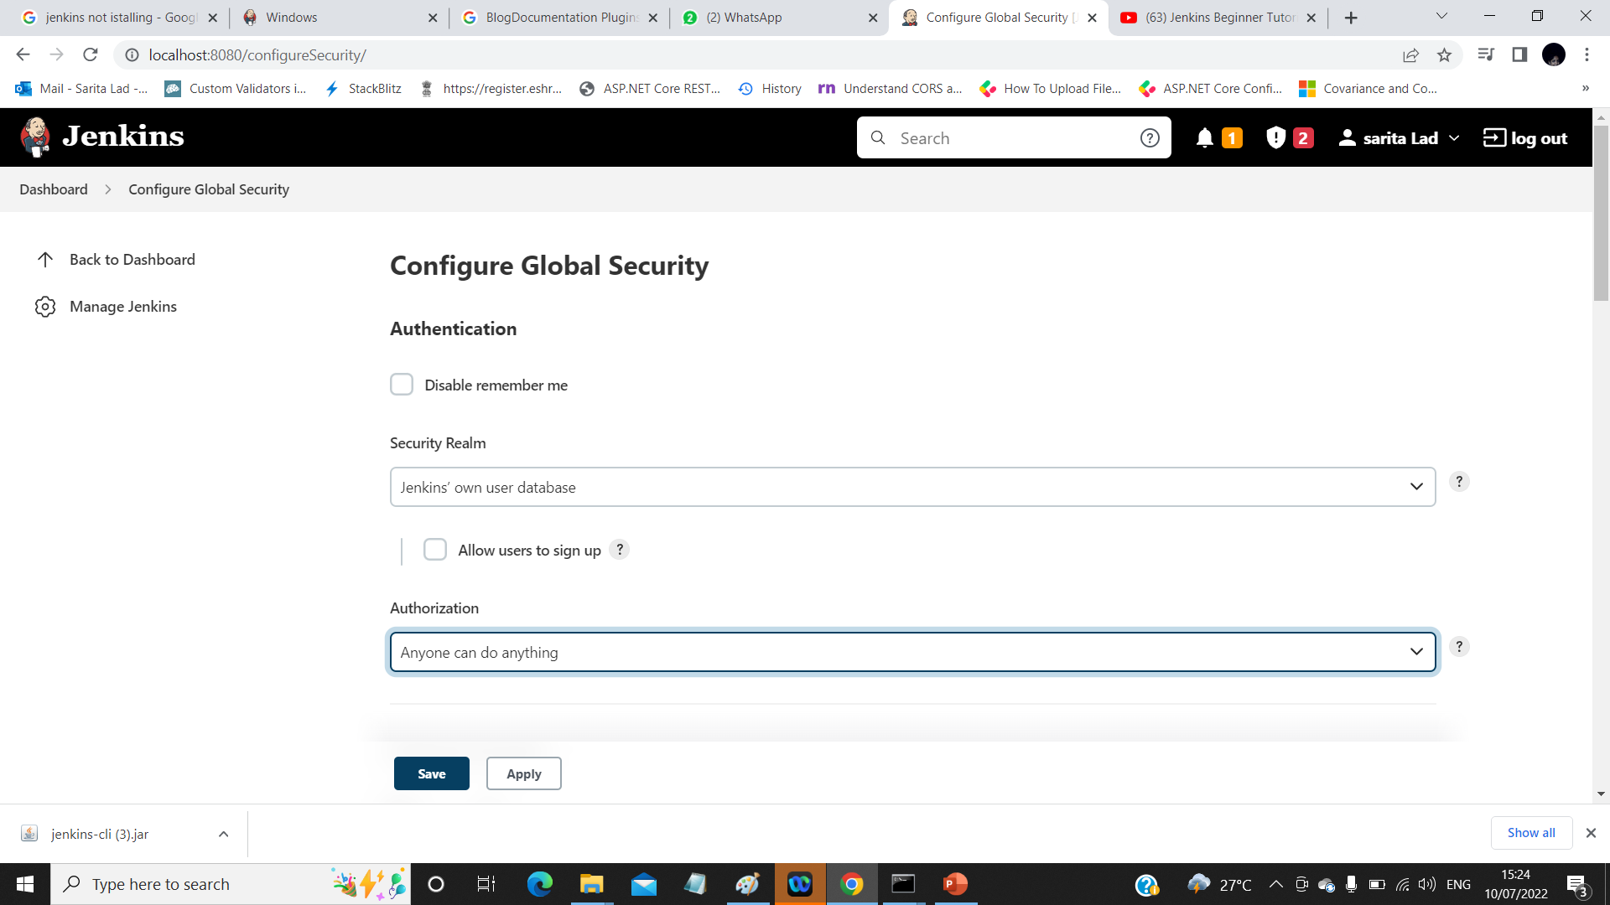




Slide 8
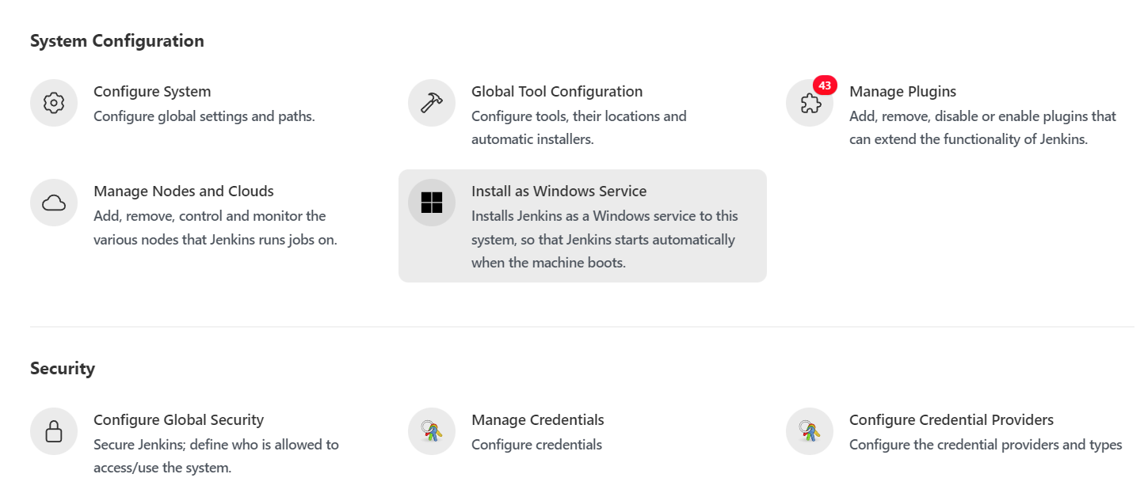



Slide 9
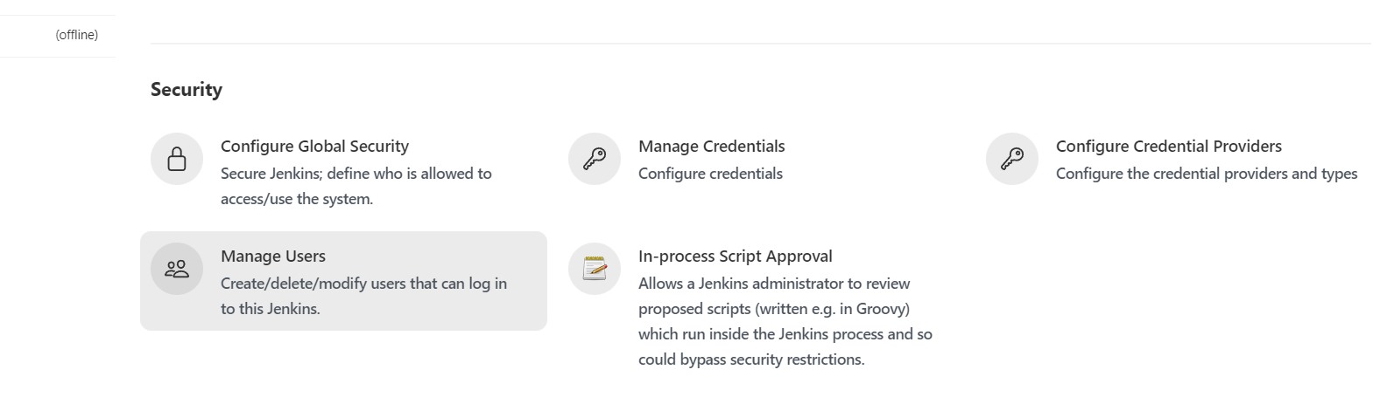









How to create Users + Manage + Assign Roles
Step 1: Create New User
Step 2 :Configure User
Step 3: Create and manage user Roles
Step 4: Install Roles Strategy PlugIn + download +
Restart Jenkins
Manage Jenkins Configure Global Security =>
Authorization => Rale based Strategy

Slide 10
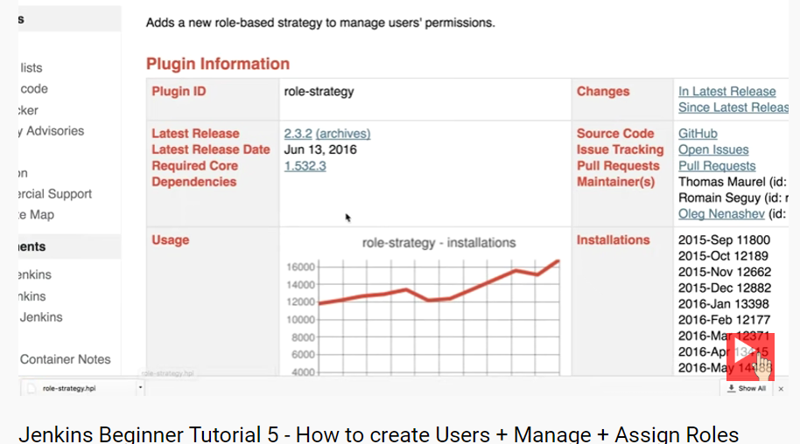



Slide 11
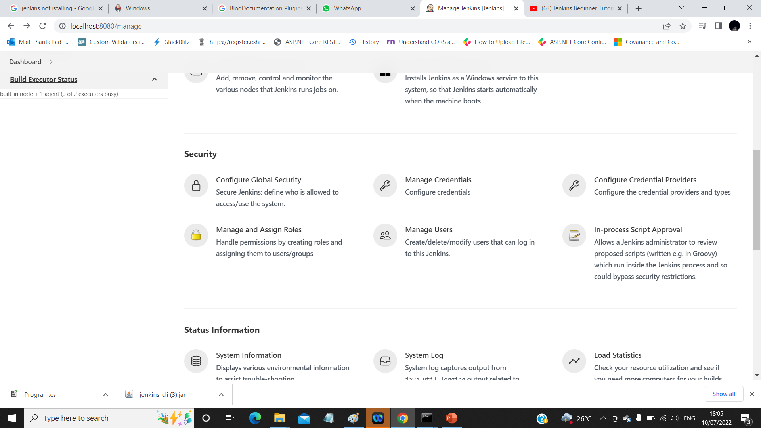
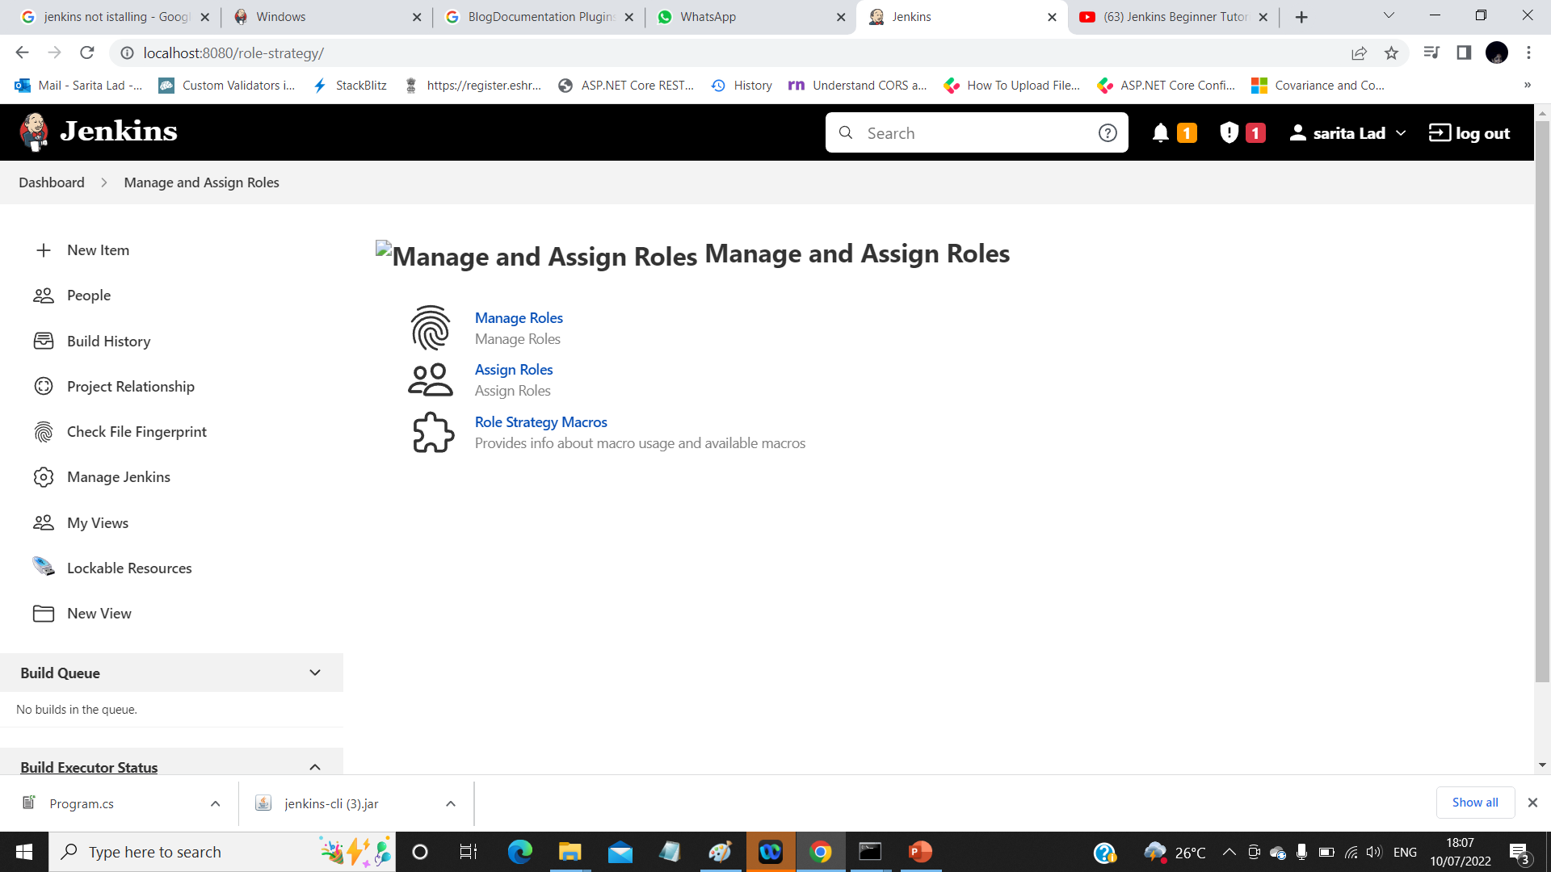

echo %date%
Dir
This menu is available only after install and select Role based Authorization is
Selected in Configure Global Security :
D

Slide 12
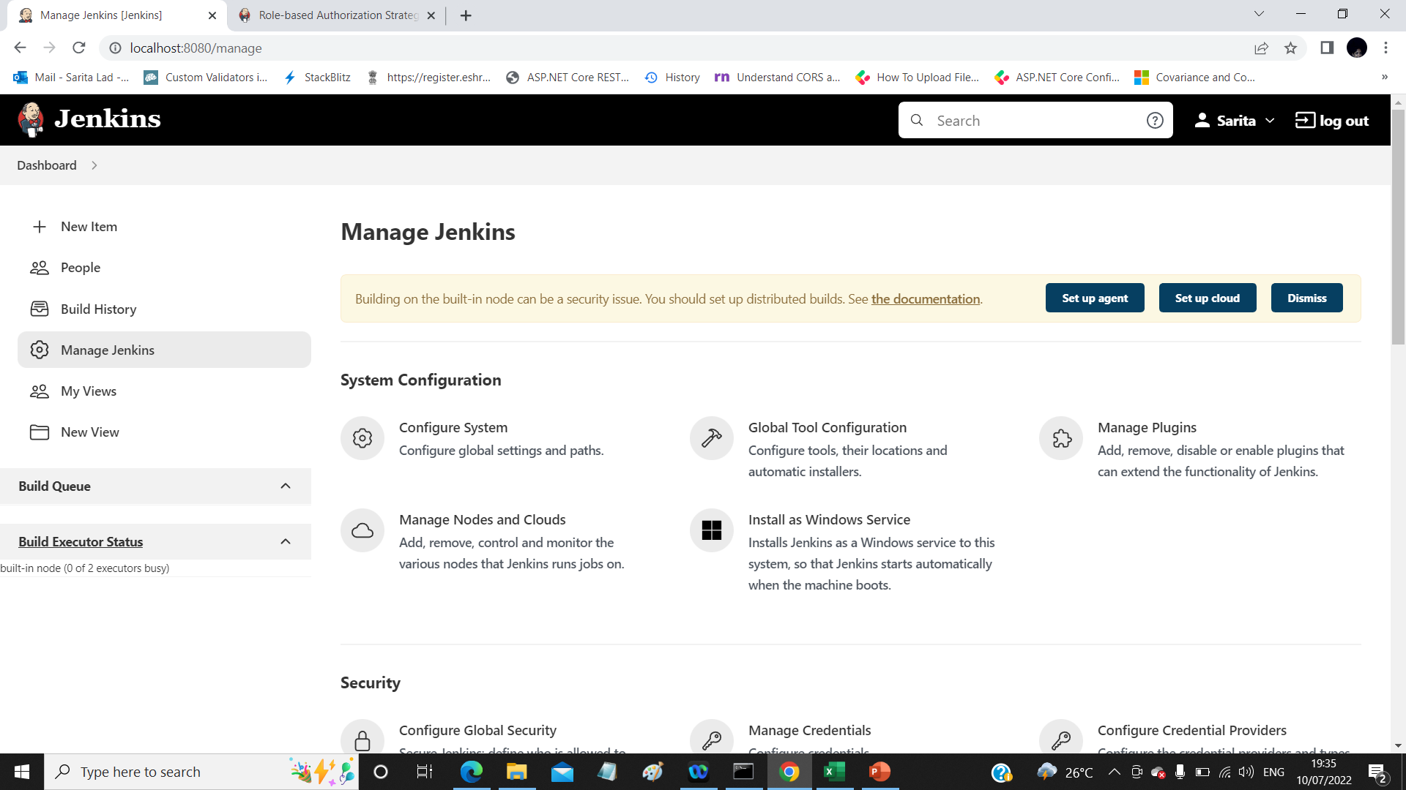
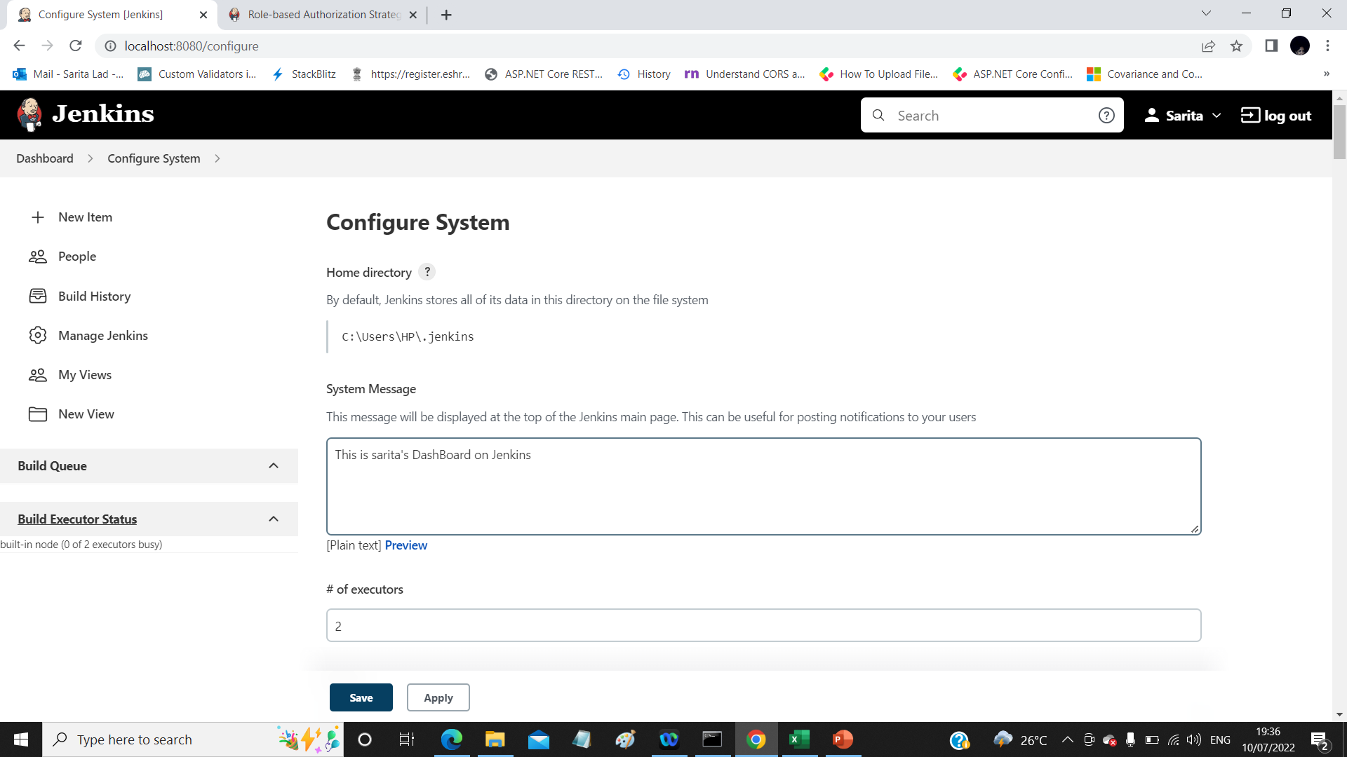

Slide 13
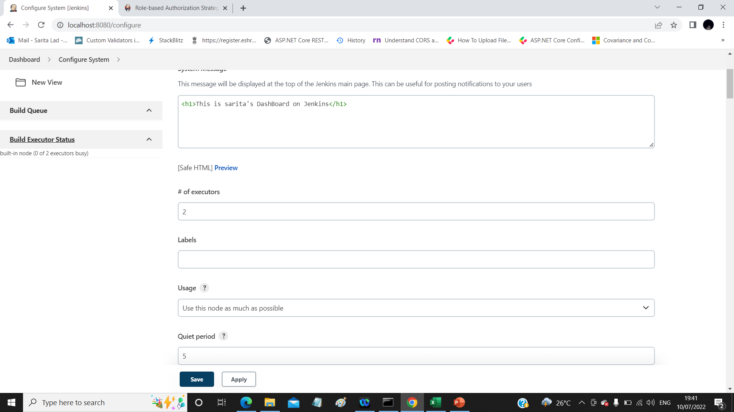

Number of parallel jobs at a time can run is 2

Slide 14
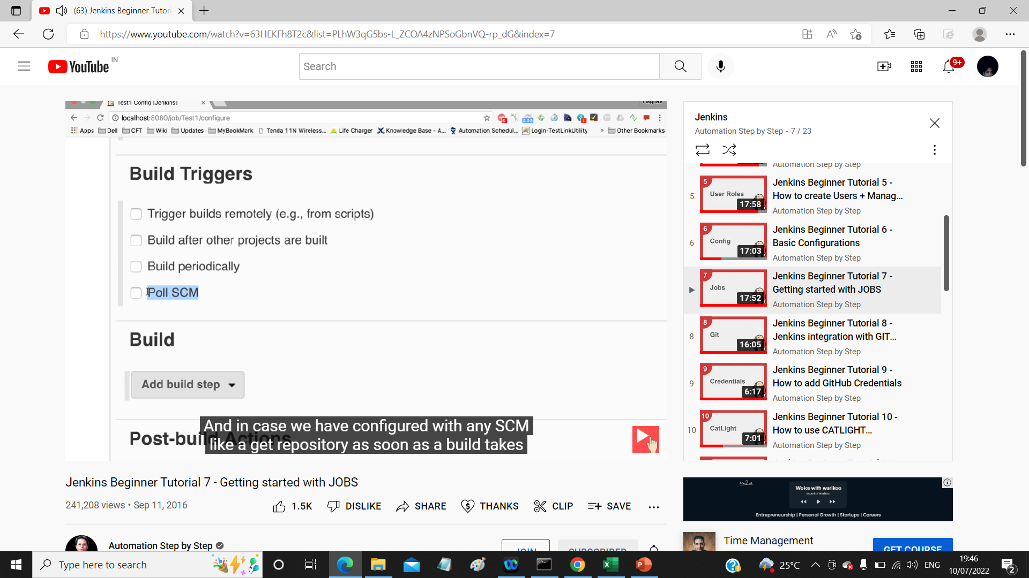
How to Create a basic job
Basic job configuration
How to run the job remotely
How to chain job Execution
Trigger remotely :
http://localhost:8080//job/consoleapp2/build?token=1234

Slide 15
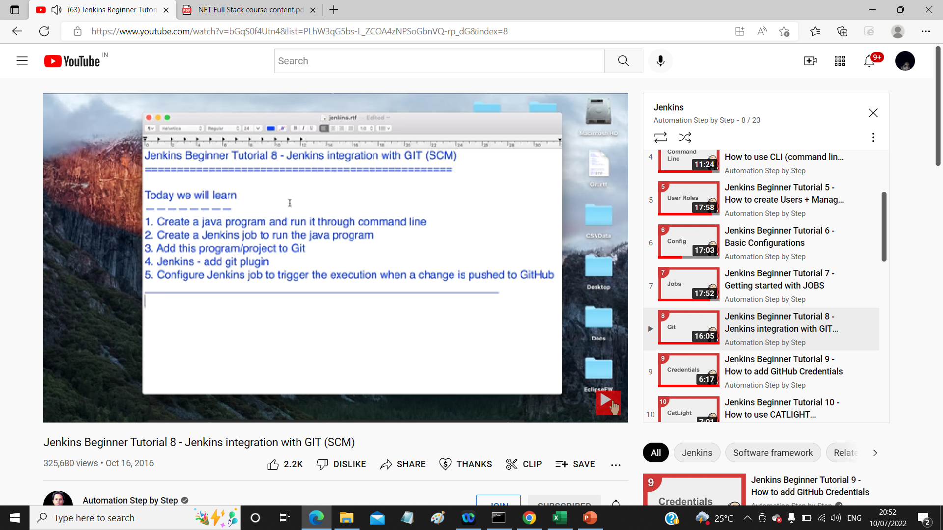

Slide 16
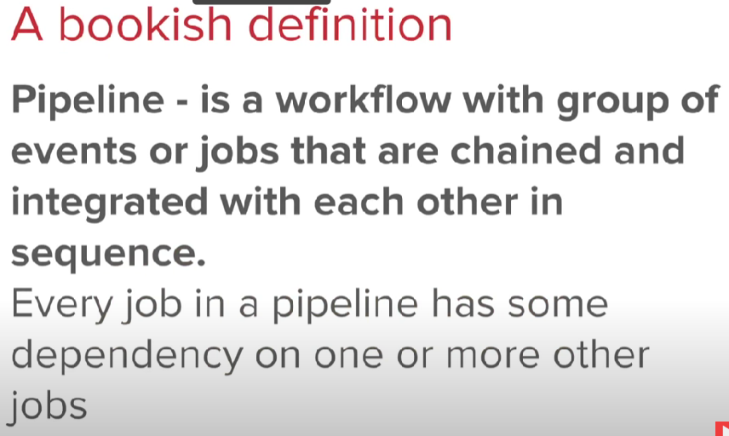
Jenkins Pipeline

Slide 17
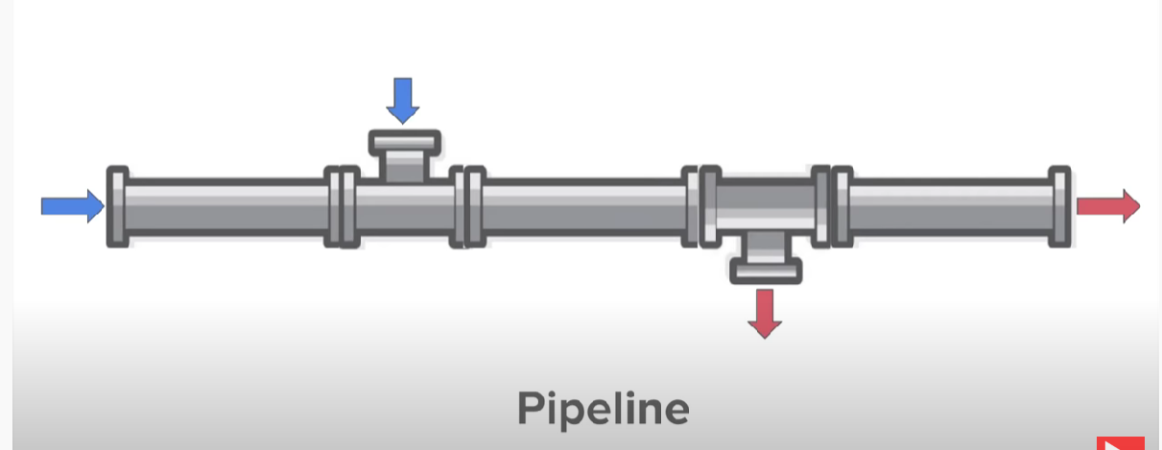

Slide 18
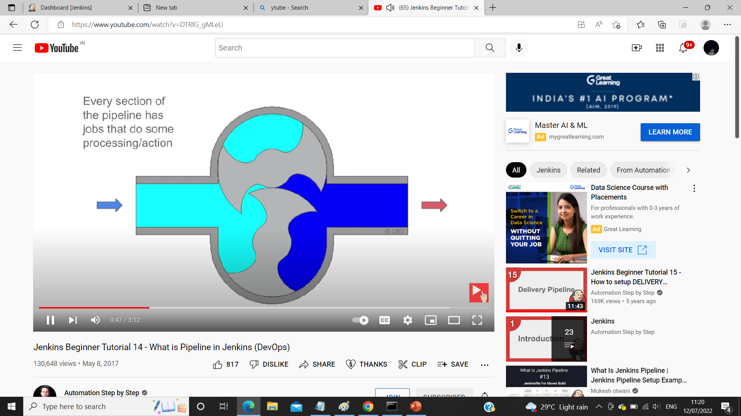

Slide 19
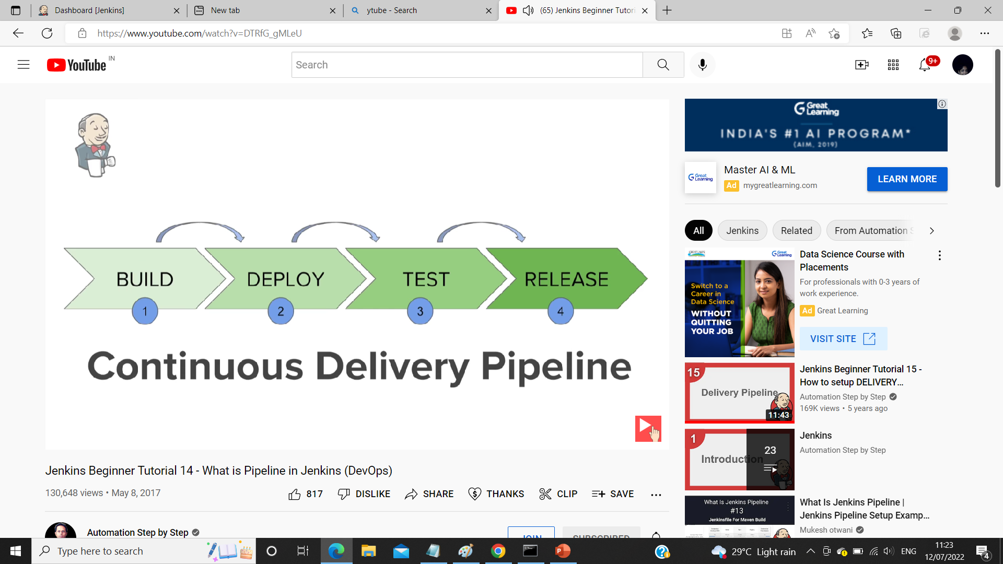

Slide 20
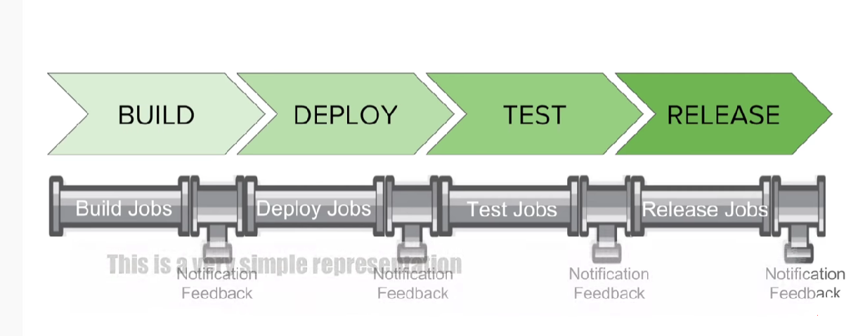

Slide 21
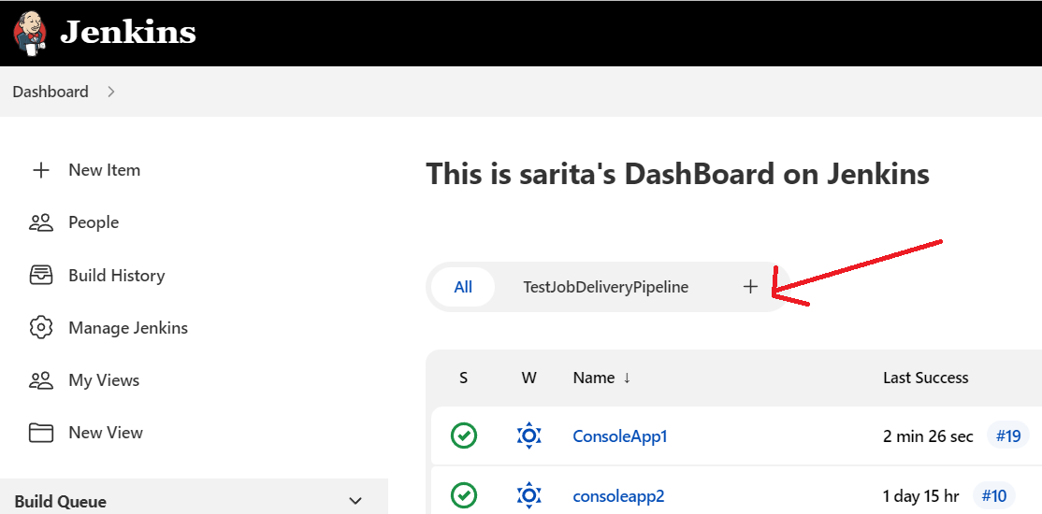
Setup Delivery Pipe Line
Step 1 :Create Sample Jobs=>SampleBuildjob,SampleDeployejob,SampleTestjob
Step 2: chain them using Build Trigger in SampleDeployjob and SampleTestjob
Step 3: install Delivery Pipeline => Manage Jenkins=>Manage Plugins => Available tab
Step 4 :Install Delivery Pipeline ( or google search and install ) Restart machine
Step 5: Start Jenkins and on DashBoard Click Plus + sign on top

Slide 22
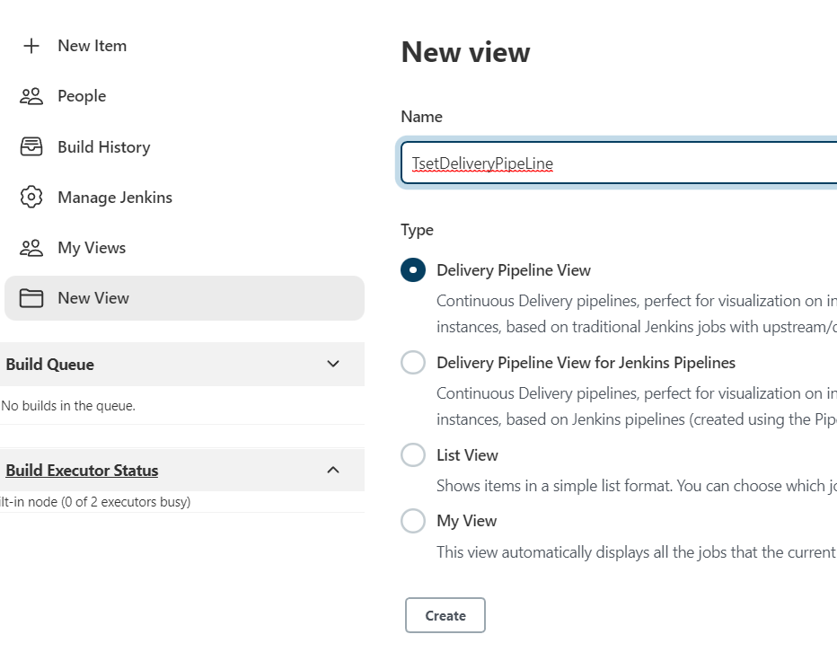

Slide 23
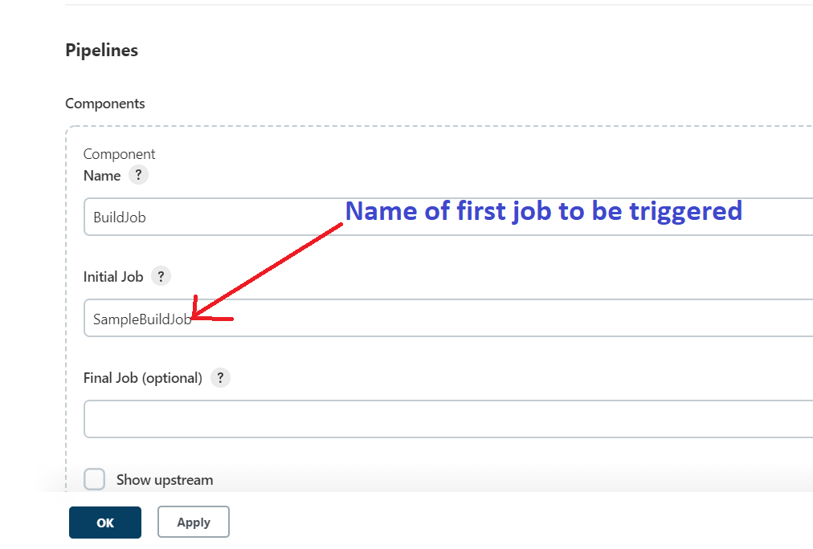
Component to be added in Delivery pipeline

Slide 24
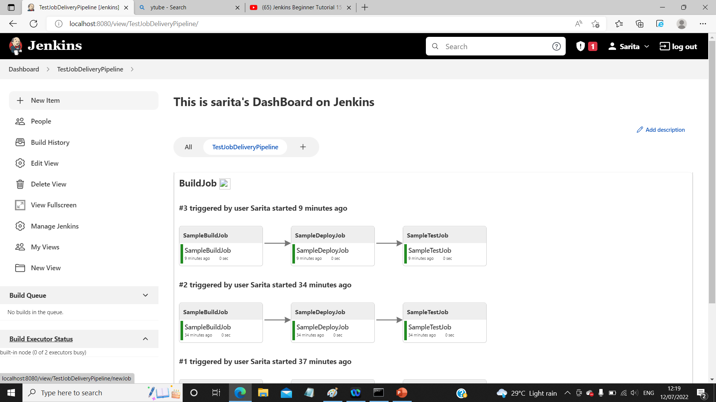


Slide 25
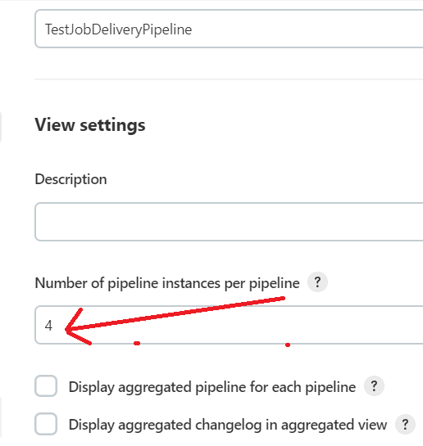
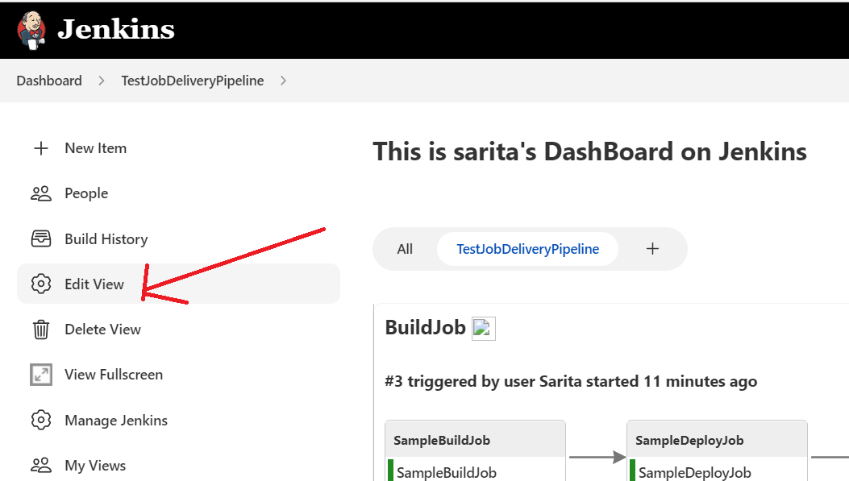
Edit Delivery PipeLine:

Slide 26
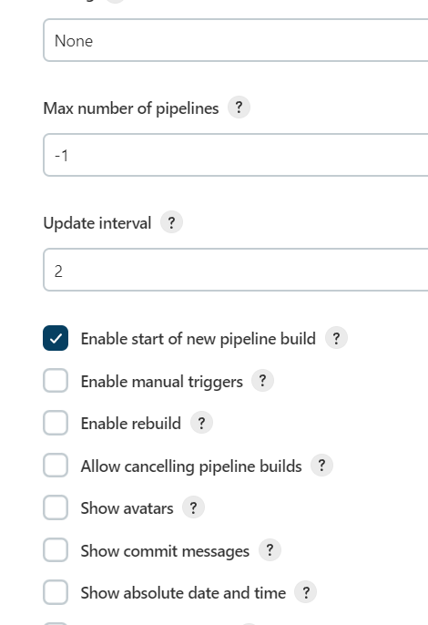
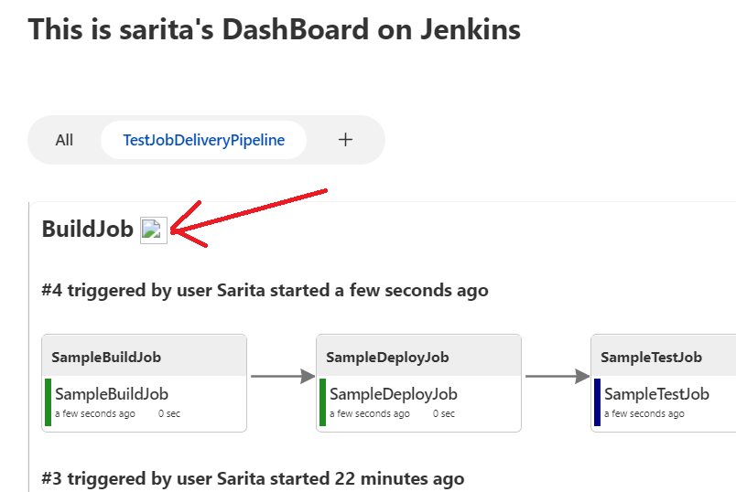
Edit View
Enable start of new pipeline build
Button is created

Slide 27
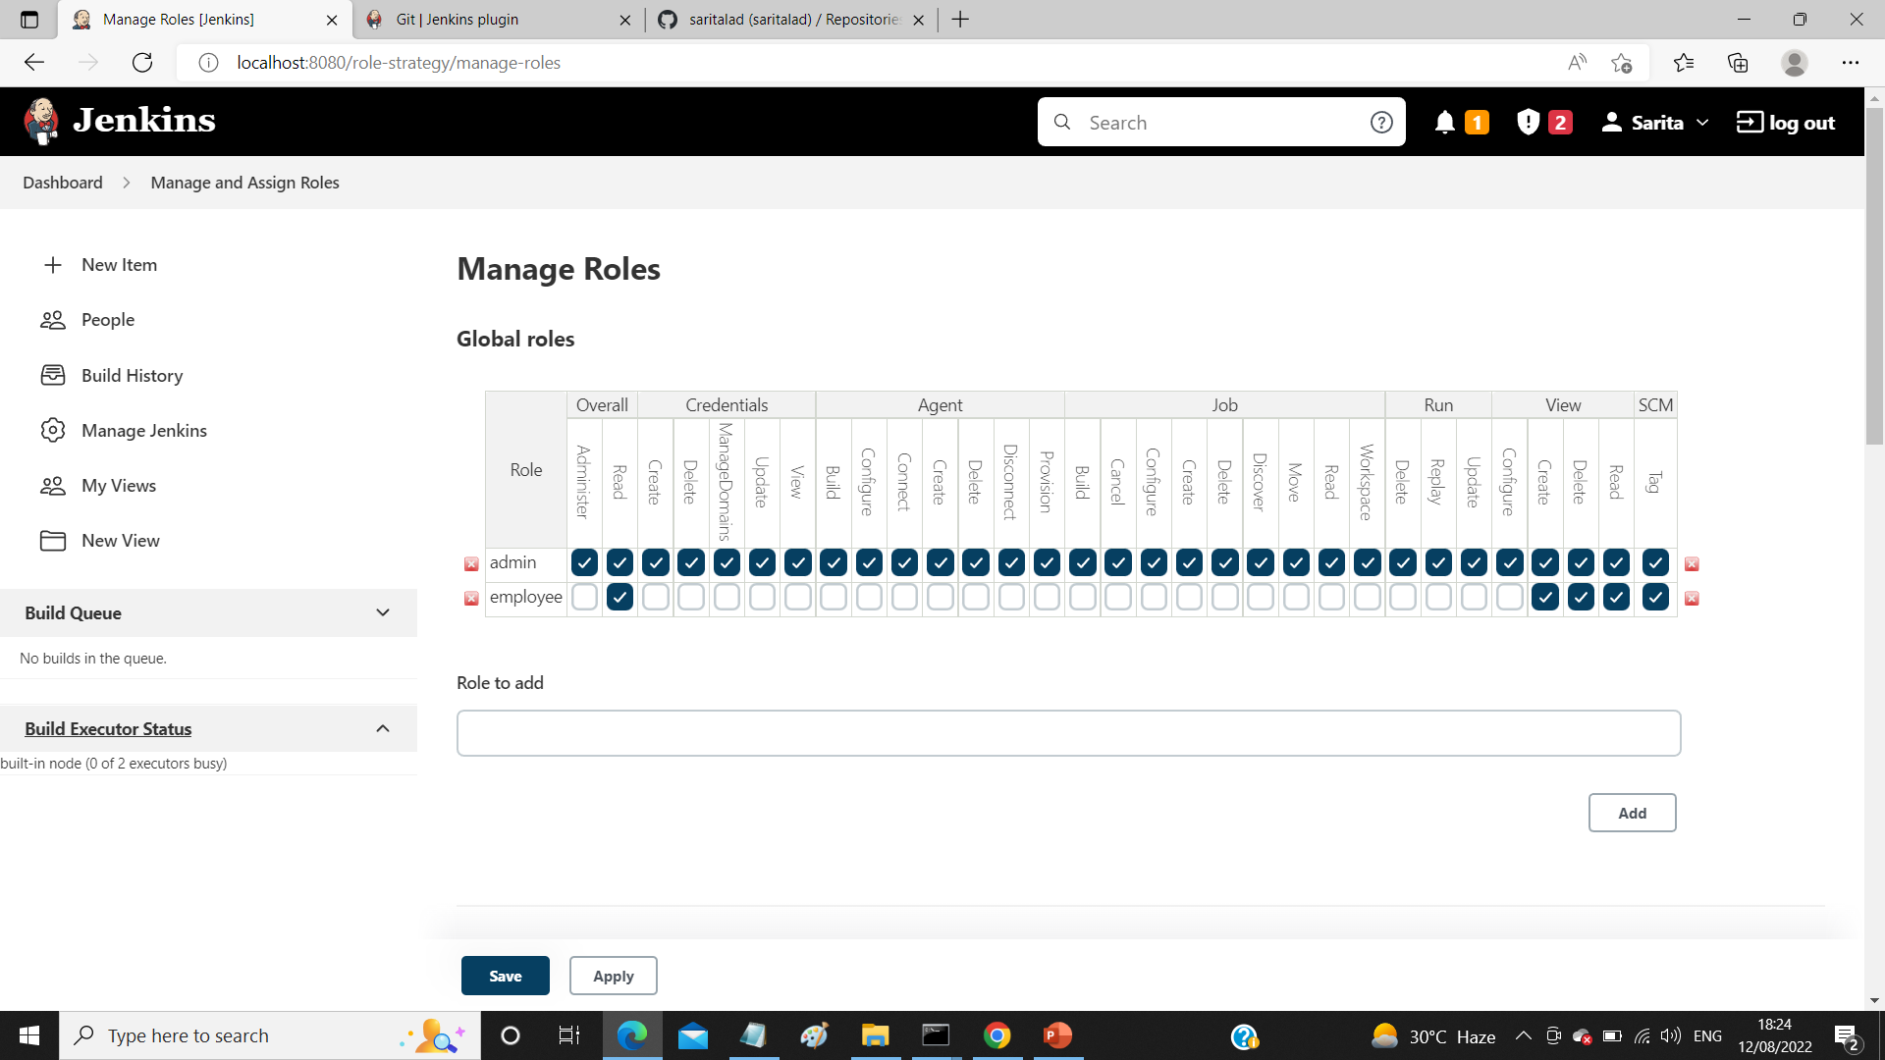
Manage Roles and Users

Slide 28
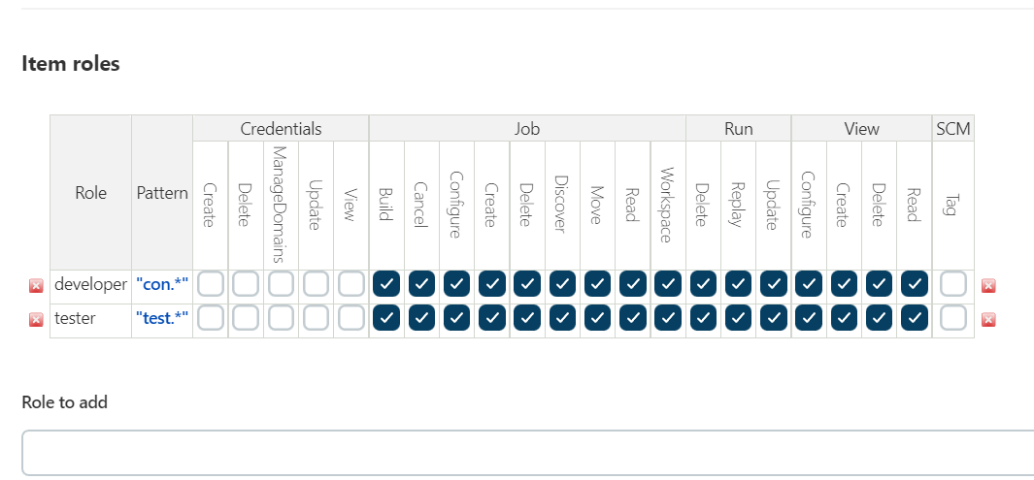

Slide 29
Thank You

